Slide 1
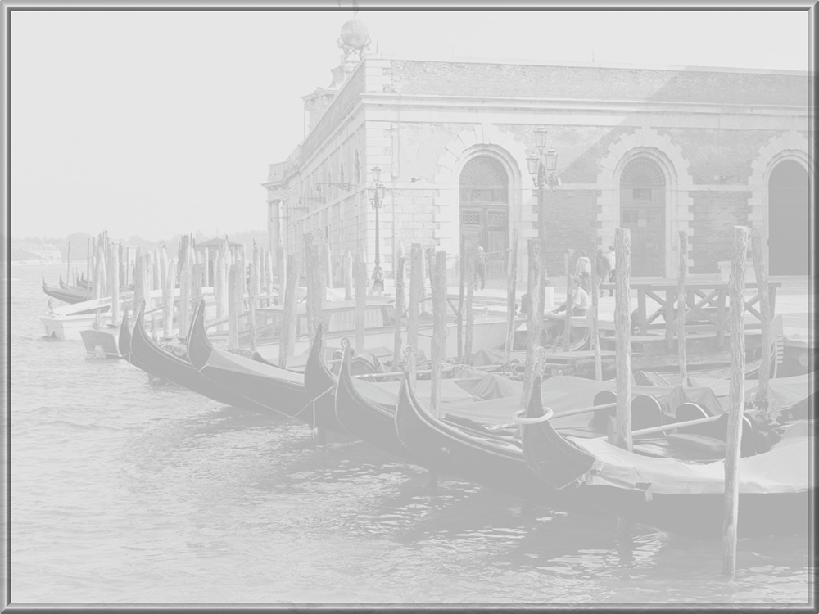
CS 236501
Introduction to AI
Tutorial 4
A*

Slide 2
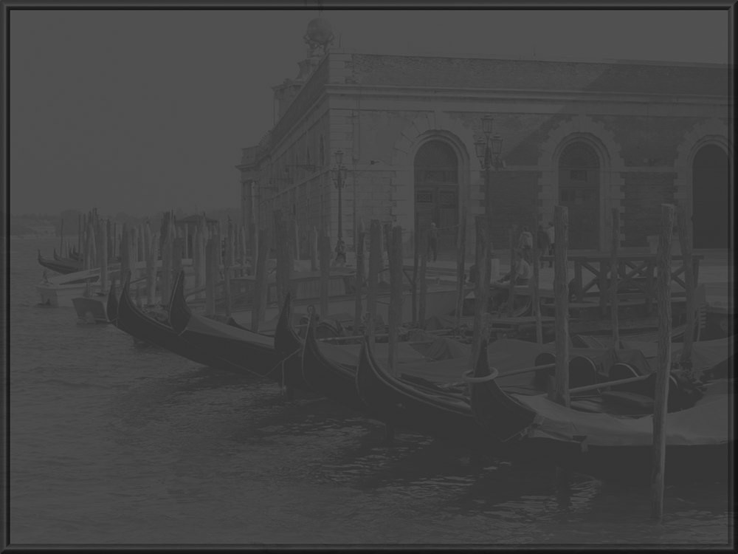

A* Search Algorithm
Evaluation function f(n) = h(n) + g(n)
h(n) estimated cost to goal from n
g(n) cost so far to reach n
A* uses admissible heuristics, i.e.,
h(n) ≤ h*(n) where h*(n) is the
true cost from n.
In the lecture you proved that:
What if:
h = 0 ? h = h* ?
h is not admis.?
h is monotonic?
A* Search finds the optimal path

Slide 3
Definitions
Problem definition:
  Initial state (InitState)
  Successor function (Succ)
  Goal predicate (Goal-p)
  Heuristic function (h)
  Cost function (Cost-f) : state x state -> cost

Slide 4
Definitions
Node
  The state that the node represents (state)
  Cost of path to the state (g)
  Heuristic value of node (h)
  Node evaluation (f = g+ h)
  The node through which we reached ‘state’ (parent)
Open, Closed will contain Nodes

Slide 5
A*
AStar(Problem p)
{
n0 <- Node(state = p.InitState,
g = 0,
h = h(p.InitState),
f = h(p.InitState),
parent = NULL)
Open <- {n0}
Closed <- {}

Slide 6
A* (contd.)
While Open ≠ {}
{
curr-Node <- Pop first from Open
curr-State <- curr-Node.state
if p.Goal-p(curr-State) == true
return SolutionPath(curr-Node)
// Not goal
Closed <- Closed + curr-Node
successors <- p.Succ(curr-State)

Slide 7
A* (contd.)
for new-State in successors do
{
new-g <- p.Cost-f(curr-State, new-State)
if new-State exists in Open
{
old-Node <- Find new-State in Open
if (old-Node.g > new-g)
{
Open <- Open \ {old-Node}
old-Node.g <- new-g
old-Node.f <- new-g + old-Node.h
old-Node.parent <- curr-Node
Open.insert(old-Node,old-Node.f)
}
}

Slide 8
A* (contd.)
else if new-State exists in Closed
{
old-Node <- Find new-State in Closed
if (old-Node.g > new-g)
{
Closed <- Closed \ {old-Node}
old-Node.g <- new-g
old-Node.f <- new-g + old-Node.h
old-Node.parent <- curr-Node
Open.insert(old-Node,old-Node.f)
}
}

Slide 9
A* (contd.)
else // A completely new node
{
new-Node <- Node(state = new-State,
g = new-g,
h = p.h(new-State),
f = g + h,
parent <- curr-Node)
Open.insert(new-Node, new-Node.f)
}
} // end of for
}
} // end of AStar

Slide 10
A* (contd.)
Insert(Node, f) inserts a node into a list according to its priority value
SolutionPath(Node n)
{
Path <- {}
curr-Node <- n
while curr-Node ≠ NULL do
{
Add curr-Node.state to the start of Path
curr-Node <- curr-Node.parent
}
return Path
}

Slide 11
B
2714
start
City Map
300
200
50
630
Q
2848
P
1841
N
2427
600
780
685
950
570
1350
1430
I
1190
C
1170
W
1974
120
700
890
A
1318
1025
1220
1080
M
725
K
480
740
775
340
J
1666
O
0
730
870
600
goal

Slide 12
Map Representation
*Cities* = {(c, x, y) | c is a city name,
x, y are the city coordinates}
*Cities* = {(Atlanta 84.23 33.45), (Boston 71.05 42.21)
(Chicago 87.37 41.5), (Indianapolis 86.1 39.46)
(Jacksonville 81.4 30.22), (Kansas-City 94.35 39.06)
(Memphis 90.03 35.09), (New-York 73.58 40.47)
(Oklahoma-City 97.28 35.26),(Pittsburgh 79.57 40.27)
(Quebec 71.11 46.49), (Wilmington 77.57 34.14)}

Slide 13
Map Representation
*Map* = {(c1, c2, d) | c1, c2 are city names,
d is the distance between c1 and c2
on a highway}
*Map* = {(Atlanta Chicago 920)...(Atlanta Wilmington 390)
. . .
(Wilmington Pittsburgh 780)}

Slide 14
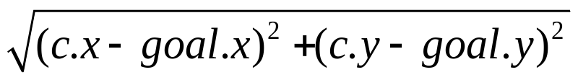
Map: Problem Definition
InitState: (Boston 71.05 42.21)
Succ(c): Cities that can be reached from c on a highway, as defined in *Map*
Goal-p: (Oklahoma-City 97.28 35.26)
h(c): Euclidian distance to destination
Cost-f(c1, c2): distance between c1 and c2 on a road, as defined in *Map*

Slide 15
B
2714 + 0
2714
Open
B
Close

Slide 16
B
2714 + 0
Open
P
N
Q
Close
B
200
630
50
Q
2848 + 200
3048
P
1841 + 630
2471
N
2427 + 50
2477

Slide 17
B
2714 + 0
Open
I
N
C
Q
A
W
Close
B
P
200
630
50
Q
2848 + 200
3048
P
1841 + 630
N
2427 + 50
2477
685
570
780
1350
I
1190 + 1180
2390
C
1170 + 1315
2485
W
1974 + 1410
3384
A
1318 + 1980
3298

Slide 18
B
2714 + 0
Open
N
C
M
Q
A
W
Close
B
P
I
200
630
50
Q
2848 + 200
3048
P
1841 + 630
N
2427 + 50
2477
685
570
780
I
1190 + 1180
C
1170 + 1315
2485
W
1974 + 1410
3384
700
890
A
1318 + 1900
3218
M
725 + 2090
2815

Slide 19
B
2714 + 0
Open
C
M
W
Q
A
Close
B
P
I
N
200
630
50
Q
2848 + 200
3048
P
1841 + 630
N
2427 + 50
685
950
570
I
1190 + 1200
C
1170 + 1315
2485
W
1974 + 1000
2974
700
890
A
1318 + 1900
3218
M
725 + 2090
2815

Slide 20
B
2714 + 0
Open
M
K
W
Q
A
Close
B
P
I
N
200
630
50
Q
2848 + 200
3048
P
1841 + 630
N
2427 + 50
685
950
570
I
1190 + 1180
C
1170 + 1315
W
1974 + 1000
2974
700
890
1025
A
1318 + 1900
3218
M
725 + 2090
2815
K
480 + 2340
2820

Slide 21
B
2714 + 0
Open
K
O
W
Q
A
J
Close
B
P
I
N
M
200
630
50
Q
2848 + 200
3048
P
1841 + 630
N
2427 + 50
685
950
570
I
1190 + 1180
C
1170 + 1315
W
1974 + 1000
2974
700
890
1025
A
1318 + 1900
3218
M
725 + 2090
K
480 + 2340
2820
740
870
J
1666 + 2830
4496
O
0 + 2960
2960

Slide 22
B
2714 + 0
Open
O
W
Q
A
J
Close
B
P
I
N
M
K
200
630
50
Q
2848 + 200
3048
P
1841 + 630
N
2427 + 50
685
950
570
I
1190 + 1180
C
1170 + 1315
W
1974 + 1000
2974
700
890
1025
A
1318 + 1900
3218
M
725 + 2090
K
480 + 2340
600
740
J
1666 + 2830
4496
O
0 + 2940
2940

Slide 23
B
2714 + 0
Open
O
W
Q
A
J
Close
B
P
I
N
M
K
630
P
1841 + 630
685
C
1170 + 1315
1025
K
480 + 2340
600
O
0 + 2940
2940

Slide 24

The end!

